Slide 1
Employee Data Analysis using Excel
NAME: R.Ramya
REGISTER NO: 312201659
DEPARTMENT: Commerce
COLLEGE:Prof dhanaplan college of science and management

Slide 2
PROJECT TITLE
Employee Performance Analysis using Excel

Slide 3


AGENDA
Problem Statement
Project Overview
End Users
Our Solution and Proposition
Dataset Description
Modelling Approach
Results and Discussion
Conclusion
3/21/2024 Annual Review

Slide 4

Problem statement
*Problem Statement* - Inefficient employee performance tracking and analysis
- Lack of data-driven insights for informed decision-making
- Limited visibility into employee strengths and weaknesses

Slide 5

Project overview
*Project Overview* - Develop an Excel-based Employee Performance Analysis Dashboard
- Automate data integration and analysis
- Provide actionable insights for employee development and resource allocation

Slide 6

WHO ARE THE END USERS?
*End User* - HR Managers - Sales Team Managers - Senior Management - Employees
The end users for the Employee Performance Analysis Dashboard
These end users will benefit from the dashboard’s ability to: - Provide clear and actionable insights into employee performance
- Identify trends and patterns in performance data
- Support data-driven decision-making
- Enhance employee development and growth
- Improve overall business performance

Slide 7

OUR SOLUTION AND ITS VALUE PROPOSITION
*Our solution and proposition*
- A comprehensive and customizable dashboard for employee performance analysis
- Automated data integration and analysis
- Actionable insights for informed decision-making
- Enhanced employee development and resource allocation
- Improved business outcomes through data-driven decisions

Slide 8
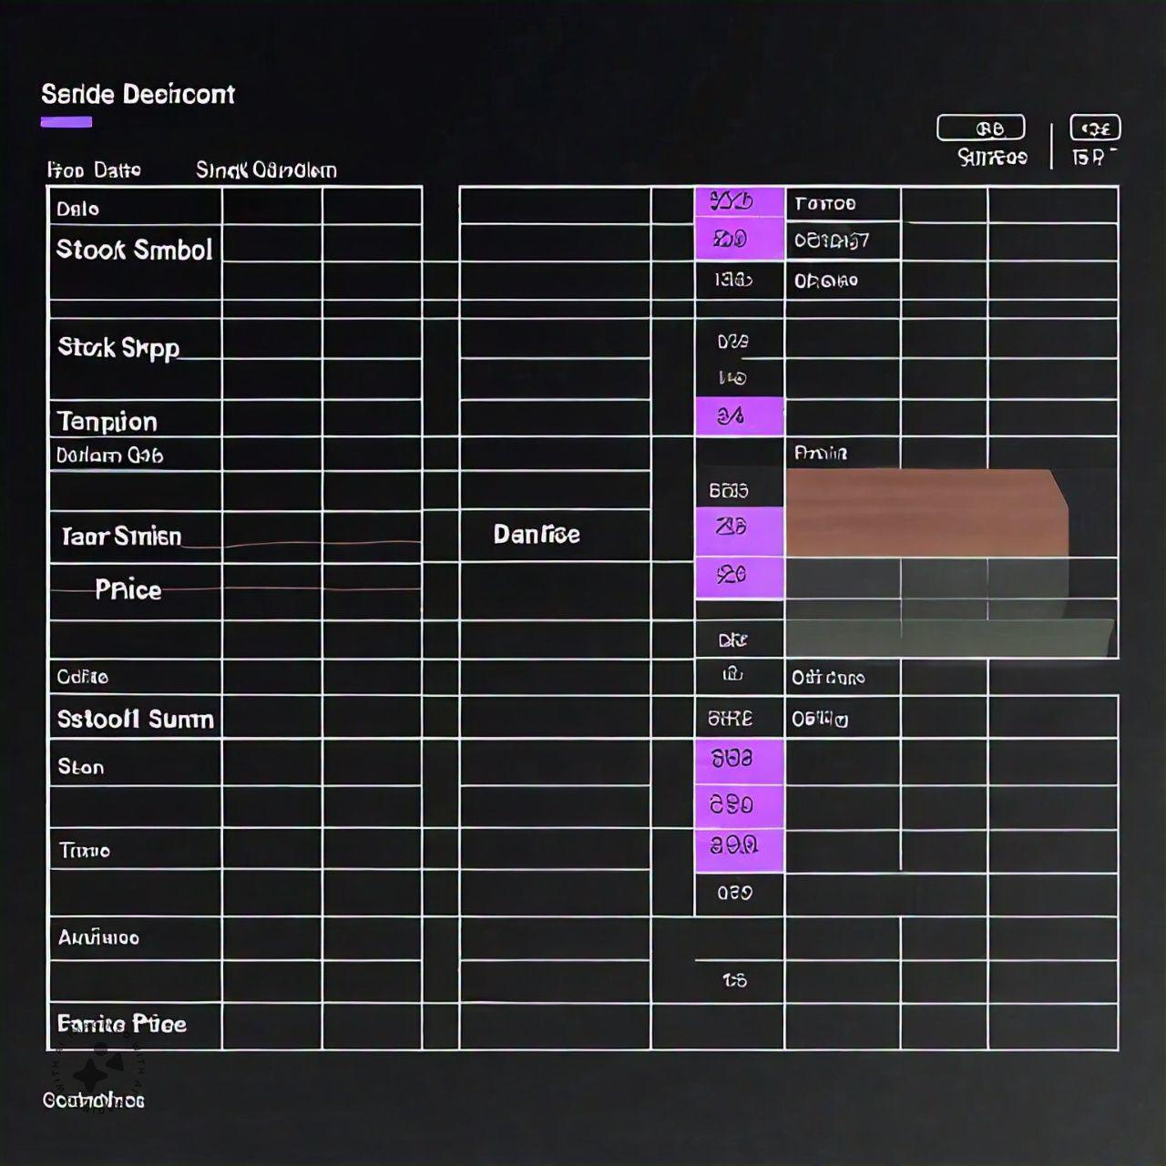
Dataset Description
*Dataset Description* - Introduction to the employee performance dataset
- Description of the variables and data types
- Summary statistics (e.g., mean, median, range) for key variables
- Data quality issues and handling procedures

Slide 9

THE "WOW" IN OUR SOLUTION
1.Identify the root cause:
Understand why the employee is delaying tasks . This could be due to personal issues, lack of skills , unclear instructions, or hight work load
2. Set clear expectations:
Ensure that job responsibilities and deadlines are clearly communicated. Define specific, measurable, achievable, relevant, and time-bound (Smart) goals
3/21/2024 Annual Review
9

Slide 10

MODELLING
*Modeling Approach* - Description of the Excel-based dashboard and its components
- Explanation of the data integration and automation processe
- Overview of the visual analytics and visualization tools used
- Discussion of the customizable and scalable feature
10

Slide 11

RESULTS
*Results* - Presentation of key findings and insights from the dashboard
- Visualizations and charts illustrating trends and patterns in employee performance
- Summary of top-performing and underperforming employees or teams
- Identification of areas for improvement and recommendations
11

Slide 12
conclusion
*Conclusion* - Recap of the key findings and insight
- Restate the benefits of using the Employee Performance Analysis Dashboard
- Final thoughts and recommendations for stakeholders
- Future directions for research development

